Slide 1
MyCo Policies and Recommendations
Team 2

Slide 2
Policies

Slide 3
Comprehensive Identity Management

Slide 4


Comprehensive Identity Management
Identification Methods
Authentication Methods
Passwords and Credentials
Clearance Access
Centrify Identity Service

Slide 5
Data Management

Slide 6

Data Management
Backup services
Disaster Recovery
Period of Retention
Data destruction
Ease of Access

Slide 7
Remote Access

Slide 8
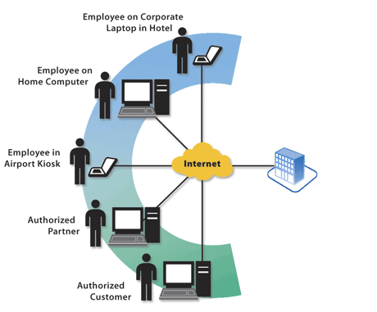
Remote Access
VPN
Virus Protection plan
Management
Third Party Agreement

Slide 9
Acceptable Use and Network Access

Slide 10

Acceptable Use and Network Access
Acceptable Use: Using MyCo’s technology resources for employee's duties.
Unacceptable Use: Copyright Infringement, Introduction of Malicious Programs, Sharing Passwords, and Spamming emails.

Slide 11
System Security Best Practices

Slide 12
System Security Best Practice
Perform asset evaluation: Software, hardware, and Inventory.
Hypothesize potential harms that could help to construct a better protection system.
Safeguard implementation to keep in mind what is already in place. Include checks on the following categories: policy and regulation, cost of security measures,
Monitor security systems to make sure they are running and online. Implement IDS and IPS to detect any hacks earlier.

Slide 13
Network Security

Slide 14

Network Security
Bluetooth Baseline Requirements
Remote Access
Router and Switch Security
Wireless Communication

Slide 15
Recommendations

Slide 16
Software Development

Slide 17
Software Development
Version Control
Centralized version control System
All the data is in one centralized server
Not very reliable
Distributed Version Control System
Peer to Peer
More reliable
Git

Slide 18
Research and Development

Slide 19
Research and Development
Helium Hard Drives
SMR Drives
Cloud Service
Asigira Cloud Backup V13

Slide 20
Quality Assurance

Slide 21

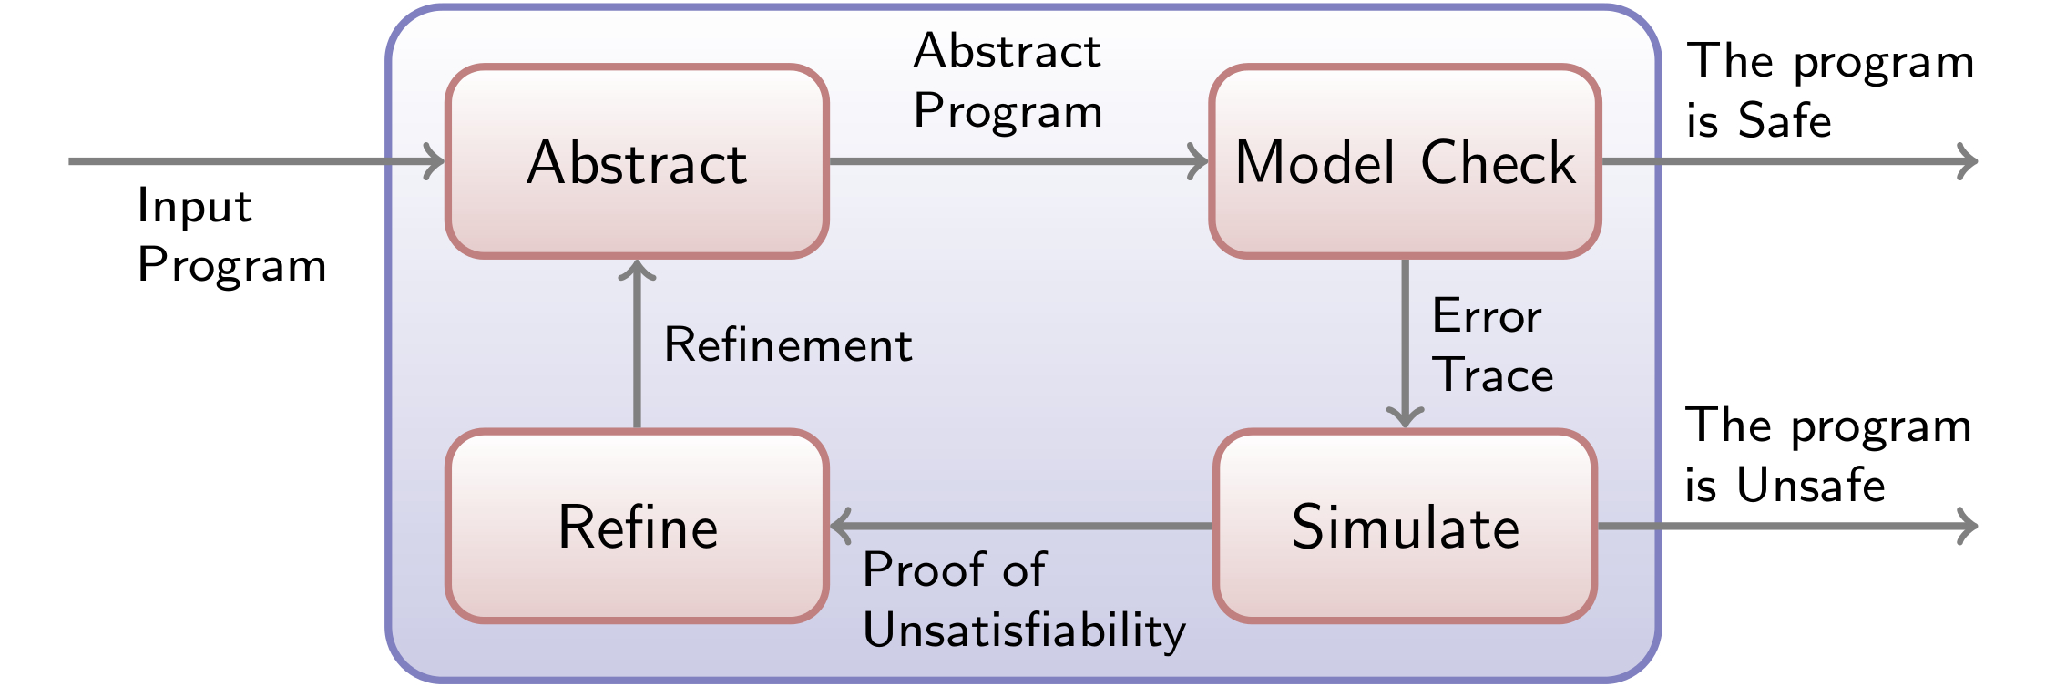
Quality Assurance
Static Analysis Tools
-FindBugs
Coding Standards
Model Checker

Slide 22
Network Administration

Slide 23
Network Administration
Designing the Network
Setting Up the Network
Maintaining the Network
Expanding the Network

Slide 24
System Administration

Slide 25
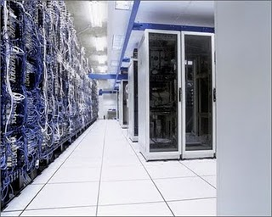
System Administration
User Classifications and Responsibilities
Operating System
Credentials
Maintenance
Troubleshooting

Slide 26
Product Sales

Slide 27
Product Sales
Per conversation with Ignatius N. Cognito, CIO of MyCo. There are no changes or recommendations to be made. The company is satisfied with their Product Sales department and architecture.

Slide 28
Customer Support

Slide 29


Customer Support
SysAid
-Ticketing
- Database
- Chat
Teamviewer
-Remote Support

Slide 30
Financial

Slide 31

Financial
Windows 10 upgrade
Multi-monitor setup
Adequate RAM
Software: By Oracle

Slide 32
Policies and Recommendations
End

